Slide 1

Association Rules
Teoh Teik Toe
ITOM/NBS
ttteoh@ntu.edu.sg
97905202

Slide 2
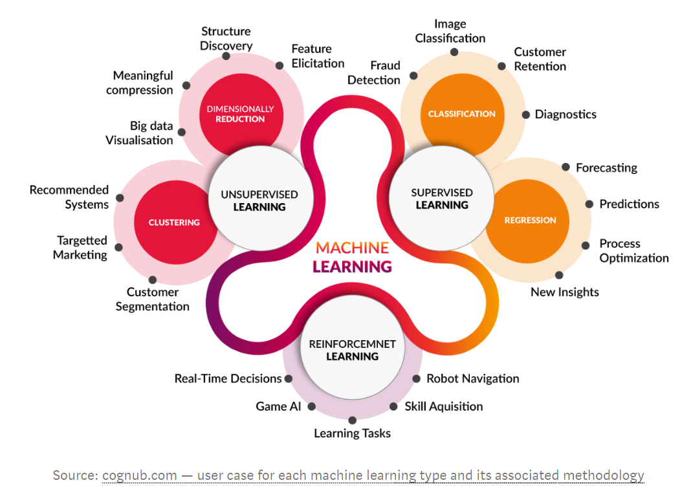

Slide 3
Applications of Association Rules
Originally started to analyze retail transaction (i.e. market basket analysis) and to:
Recommend products to Customer.
Re-design store shelfs to optimize retail sales.
Amazon.com
Netflix
Spotify
Basic Analytics in most Recommendation System

Slide 4
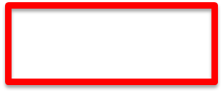
Association Rules
Find patterns (if any) in the data without depending on Y.
Prediction Problems
Supervised Learning
Unsupervised Learning
Estimation
Classification
Predict a variable (Y) value.
Clustering
Association Rules
Y is discrete
Y is continuous

Slide 5
Concepts in Association Rules
Itemset
A set of items in a transaction. An itemset of size 3 means there are 3 items in the set.
Association Rule
Form: X => Y
X associated to Y.
X is the “antecedent” itemset, Y is the “consequent” itemset.
There might be more than one item in X or Y.

Slide 6
3 Key Concepts in Association Rules X => Y
Define the following in terms of Probability:
Supp (X) ≡ P(contains X)
Supp (X and Y) [aka Rule Support] ≡ P(contains X and Y)
Conf (X => Y) ≡ P(contains Y|contains X)
Source: Chew C.H. (2020) AI, Analytics and Data Science Vol. 2.
Notes:
If define Conf = P(Y | X). But by def, P(Y|X) = P(X and Y)/P(X), what is X intersect Y? Typically no intersection of X and Y items.

Slide 7
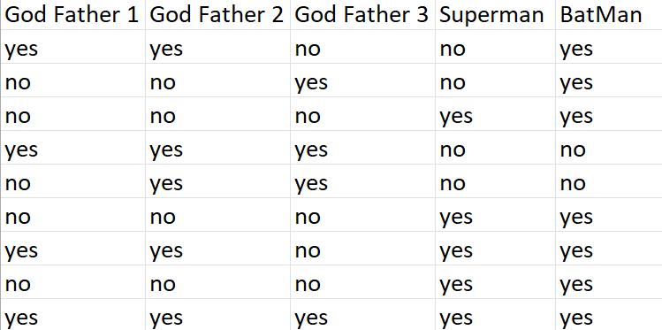
A Simple Numerical Example (Answers)
Rule: {Godfather1, Godfather2} -> Batman
Supp ({Godfather 1, Godfather 2) = 4/10
Confidence of the rule = 3/4
Notes:
Kahoot

Slide 8
Association rules in Python
import pandas as pd
df = pd.read_csv(Movie.csv')
df = df.replace("yes", 1).replace("no", 0)
print(df)
from mlxtend.frequent_patterns import apriori, association_rules
items = apriori(df, use_colnames=True, min_support=0.2)
print(items)
rules = association_rules(item, metric = 'confidence', min_threshold=0.6) #next try 0.8
print(rules)

Slide 9
example
https://youtu.be/BKbsCvE7pJA
import numpy as np
import pandas as pd
df = pd.read_csv('GroceryStoreDataSet.csv',names=['Products'],header=None)
df = list(df["Products"].apply(lambda x:x.split(',')))
from mlxtend.preprocessing import TransactionEncoder
te = TransactionEncoder()
te_data = te.fit(df).transform(df)
df = pd.DataFrame(te_data,columns=te.columns_)
from mlxtend.frequent_patterns import apriori, association_rules
items = apriori(df, min_support = 0.1, use_colnames = True)
rules = association_rules(items, metric ="confidence", min_threshold = 0.7)

Slide 10
Other example: https://www.kaggle.com/code/anurag2405/association-rules

Slide 11
Thank You

Slide 12
Association Rules using R
library(arules)
df = read.csv("C:/Users/Teoh Teik Teo/OneDrive - TSS Global Pte. Ltd/TT Library/AI Model/Data/Movie.csv")
rules = apriori(df)
inspect(rules)
inspect(head(rules))
inspect(head(sort(rules, by = "confidence"),20))
rules = apriori(df, parameter = list(support = 0.3, confidence = 0.3))
inspect(rules)

